Slide 1
Adaptive Slow Motion for Videos
Semester Project
Loïc Barben

Slide 2
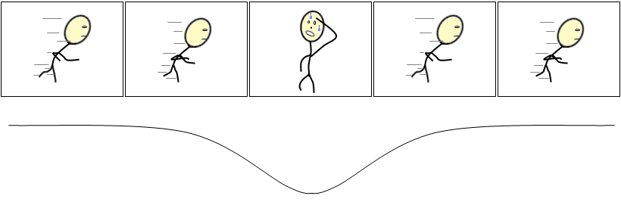
Introduction
Videos have dynamism
Dynamism : speed of objects or camera
Goal : adapt video play time to the dynamism of the scene
motion
time

Slide 3
Plan
Kinds of Optical Flows
Approaches and the one chosen
Implementation of my solution
Results

Slide 4
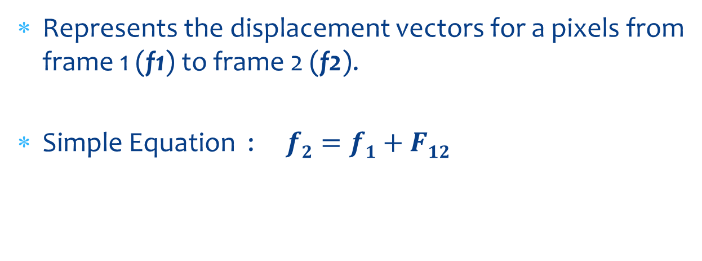
Optical flow
Represents the displacement vectors for a pixels from frame 1 (f1) to frame 2 (f2).
Simple Equation : $f2=f1+F12$

Slide 5
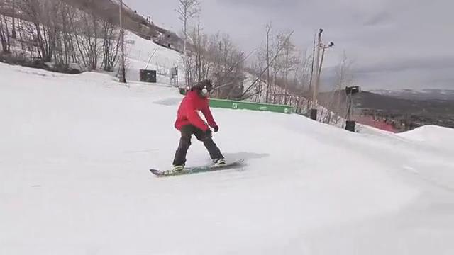
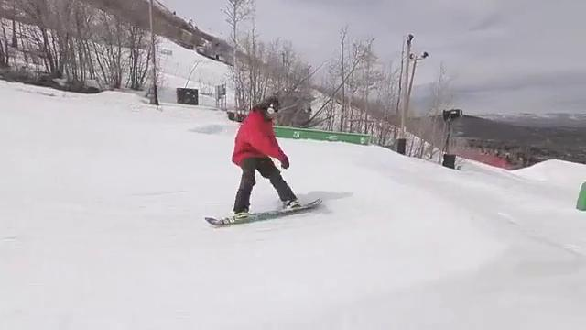
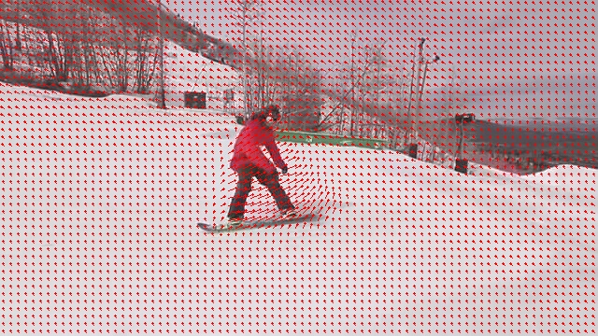

Optical flow
→ Forward $f2=f1+F12$
Flow
Frame 1
Frame 2

Slide 6
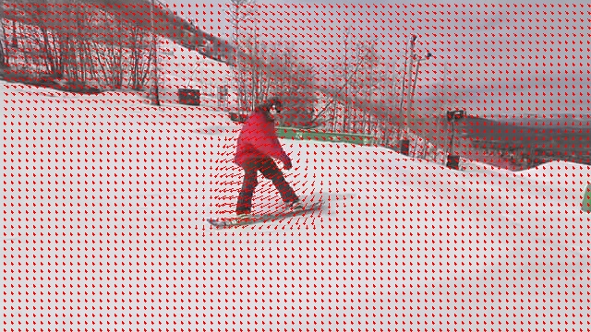

Optical flow
→ Backward $f1=f2+F21$
Flow
Frame 2
Frame 1

Slide 7
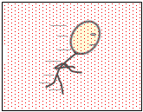
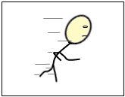
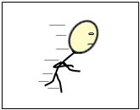
Optical flow
Multi-frames (or 2nd order)
F13
F12
F23
f1
f2
f3

Slide 8
Optical flow
1 method tried, 2 others implemented :
Ce Liu (CPU)
Farneback (CPU)
Brox (GPU)

Slide 9
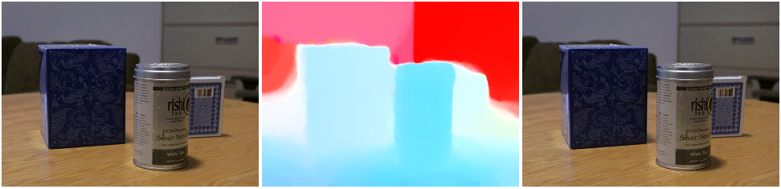
Optical flow
→ Ce Liu*
Different approach (Energy Minimization : IRLS)
+ : seems to have a better quality, mutli channels support (r,g,b)
- : a bit slow, c++ code broken somewhere
* LIU, C. Beyond pixels: Exploring new representations and appli-
cations for motion analysis. Tech. rep., Doctoral Thesis. Mas-
sachusetts Institute of Technology.

Slide 10
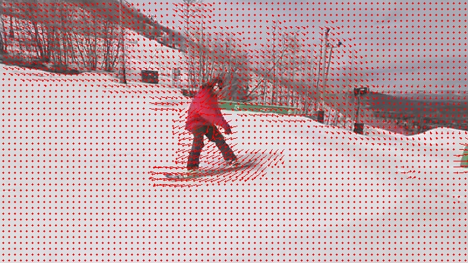
Optical flow
→ Comparison : Farneback vs Brox
Farneback (CPU, performance settings)
Brox (GPU, performance settings)
Fastest
Easiest to tune
Better quality in general
If GPU good, is also fast

Slide 11
Approaches
Use Point Trajectories
Use Object Segmentation
Own solution : Vector Clustering

Slide 12
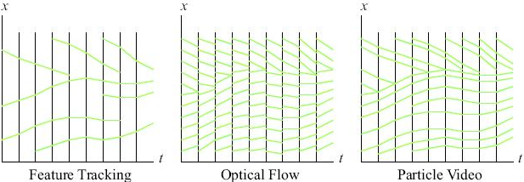
Approach
→ Particle Video*
Or Long-Range Motion Estimation Using Point Trajectories
* SAND, P., AND TELLER, S. J. 2006. Particle video: Long-range
motion estimation using point trajectories. In CVPR (2), IEEE Computer Society, 2195–2202.

Slide 13
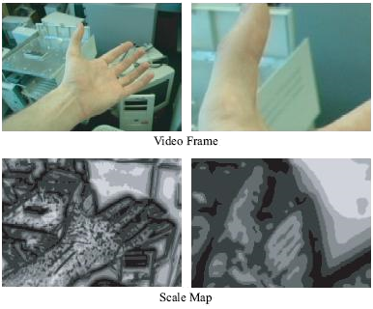
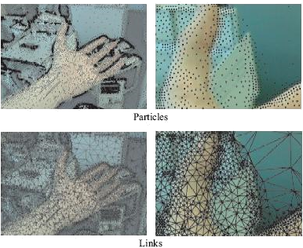
Approach
→ Particle Video
1
2
3
4

Slide 14

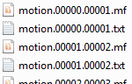
Approach
→ Particle Video
Video input (7 sec)
→ About 5h of computation at 3.7Ghz
171’524 tracked points

Slide 15
Approach
→ Particle Video
Video
7 sec, 492x360
9 sec, 960x540
Output size
897 MB
136 MB
Tracked Points
5h10
51min, failed
10 sec, 1280x720
23 sec, 640x360
1.43 GB
> 729 MB
Computation time
97’051
7h46
> 8h
171’524
2’590
102’325
Format : [start frame] [end frame] [p.x p.y] [p.x p.y] …

Slide 16
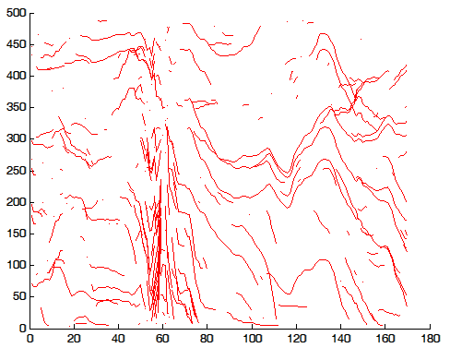
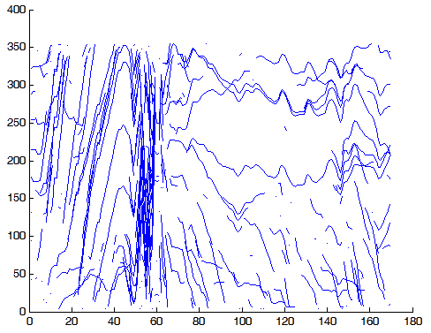
Approach
→ Particle Video
Uniform sampling (250/171’052)
Y : width
Y : height
X : frames number 1-169

Slide 17
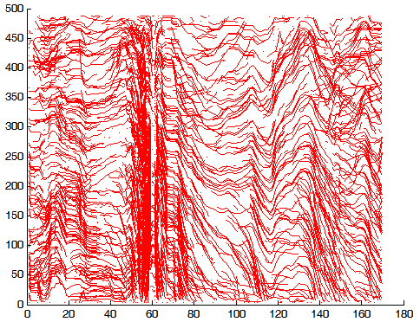
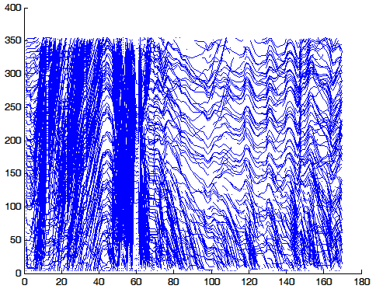
Approach
→ Particle Video
Uniform sampling (2’500/171’052)
Y : width
Y : height
X : frames number 1-169
X : frames number 1-169

Slide 18
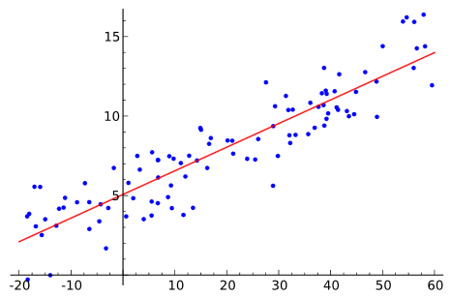
Approach
→ Particle Video → CCToolbox*
Tool for clustering curves using Matlab.
Need to convert to output of Particle Video in Matlab format.
Clustering parameters :
K = 3
Method = Linear Regression
wikipedia
* GAFFNEY, S. J. 2004. Probabilistic curve-aligned clustering and prediction with regression mixture models. Tech. rep., Ph.D. Dissertation, 2004. Laboratoire MAS.

Slide 19
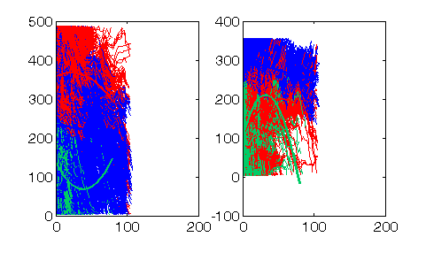
Approach
→ Particle Video → CCToolbox*
For 171’524 tracked points :
Width
Height

Slide 20
Approach
→ Particle Video → CCToolbox*
But,
Particle Video :
Way too slow to work with.
Need to reduce the number of tracking points.
Too much parameters to tune to be right.
CCToolbox :
How to find K ?
Again not fast.
Conclusion : would need too much time to get it right.

Slide 21
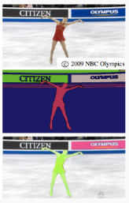
Approach
→ Graph-based video segmentation*
Idea :
Segment objects using this video oriented tool.
Use the optical flow to find the speed of the objects
Remap the time
* GRUNDMANN, M., KWATRA, V., HAN, M.,ANDESSA, I. A. 2010. Efficient hierarchical graph-based video segmentation. In IEEE CVPR, 2141–2148.
http://www.cc.gatech.edu/cpl/projects/videosegmentation/

Slide 22
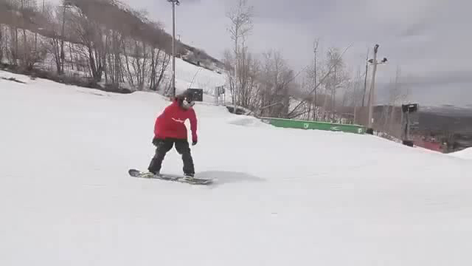
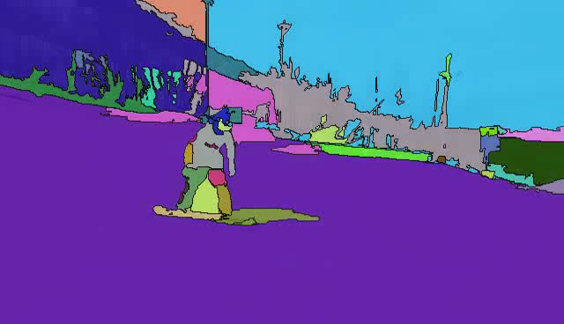
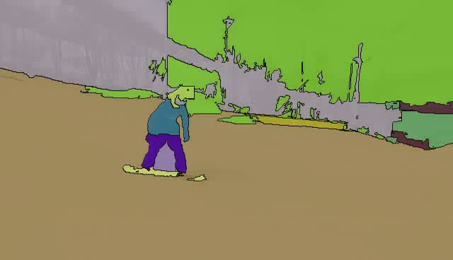
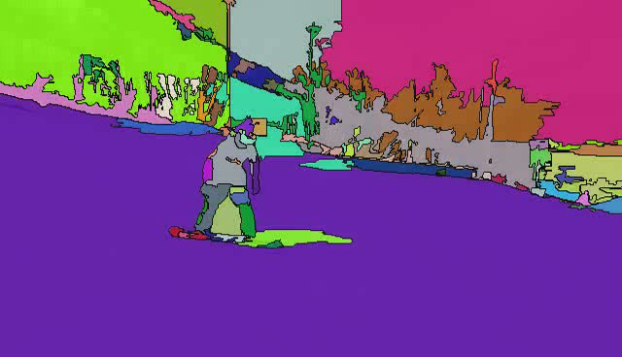
Approach
→ Graph-based video segmentation
Rendered movie at 90%, 70% and 50% of highest hierarchy level

Slide 23
Approach
→ Graph-based video segmentation
Advantages :
+ seems to work very well
+ fast
+ customizable
Disadvantages :
No framework, only a web interface
need to provide a hierarchy level for the optimal settings
Could have been the approach taken.

Slide 24
Approach
→ Own solution
Idea :
Use directly the information of the optical flow to determine the dynamism.
In short, we want to have a number that quantify the motion between two consecutive frames.
Draw a graph of the motion over time.
Remap time accordingly.

Slide 25
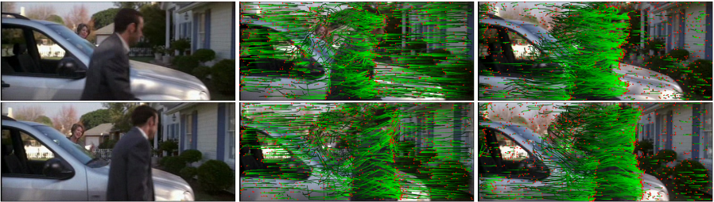
Approach
→ ω-flow* → Own solution
Problem : camera movement.
Solution : work with ω-flow :
Optical flow
ω-flow
* JAIN, M., JEGOU, H., AND BOUTHEMY, P. 2013. Better ex-ploiting motion for better action recognition. In CVPR, IEEE, 2555–2562
http://www.irisa.fr/texmex/people/jain/w-Flow/

Slide 26
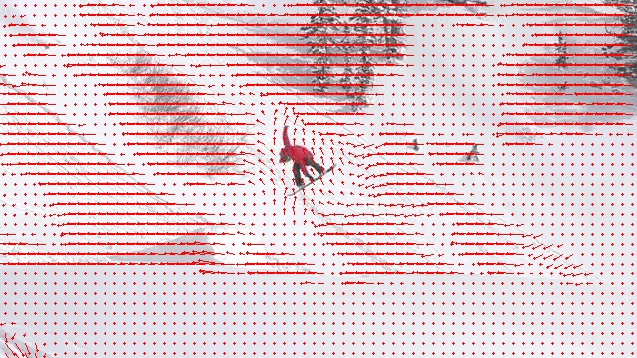
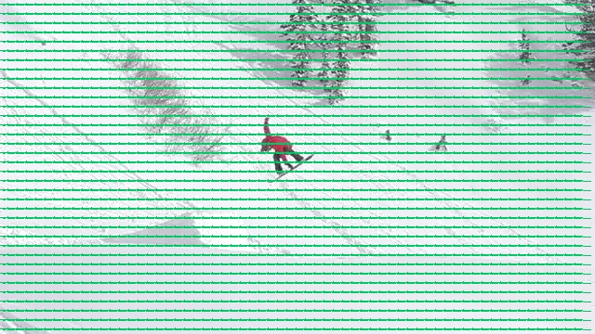
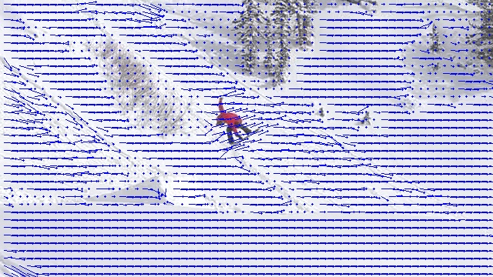
Approach
-
ω-flow
Optical flow
Affine flow
=

Slide 27
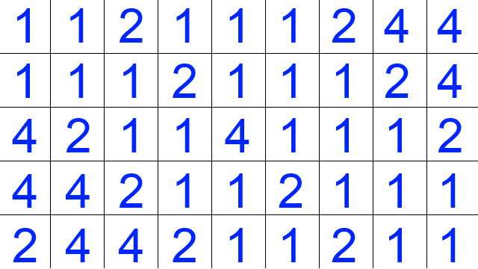
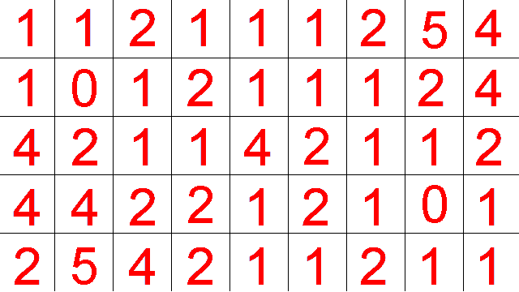
Implementation
→ Clustering
ω-flow
x
Displacement map
y

Slide 28
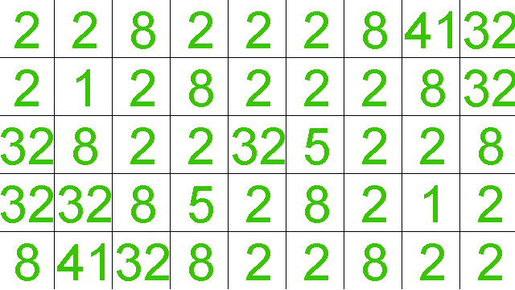
Implementation
→ Clustering
→ Clustering
Squared norm
Displacement map

Slide 29
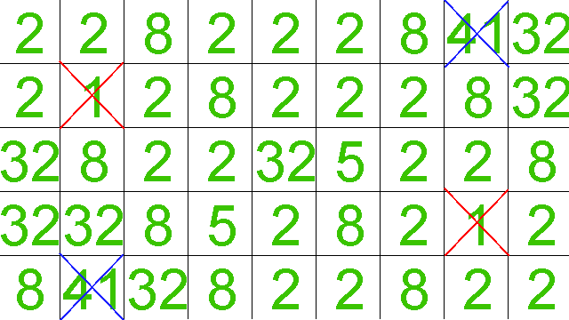
Implementation
→ Clustering
→ Clustering
Eliminate
-Background values
-Too high values
order
4.9 – 4.4 > 0.2
Parameters :
_minThreshold = 1.5
_maxThreshold = 40
_minDistInCluster = 0.2
_minClusterSize = 1
C1
C2
C3

Slide 30
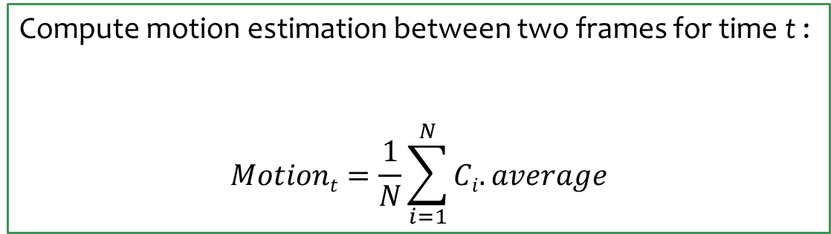
Implementation
→ Motion estimation
Compute motion estimation between two frames for time t :
$$Motiont=\frac{1}{N}\sum_{i=1}^{N}{Ci.average}$$

Slide 31
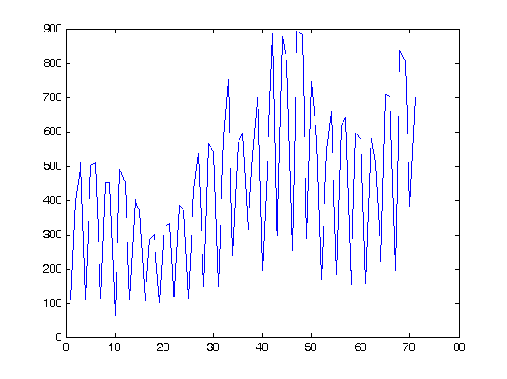
Implementation
→ Motion estimation
The optical flow values are not perfect and strongly depends on the video quality.
For example, MPEG-4 videos are decoded using I/P/B frames : some frames are drawn by interpolation. It is thus possible to have an in-between frame that is not exactly the one we expect (=not perfect as it was originally).
That’s why we can get this :
Motion estimation
Frame number (72)

Slide 32
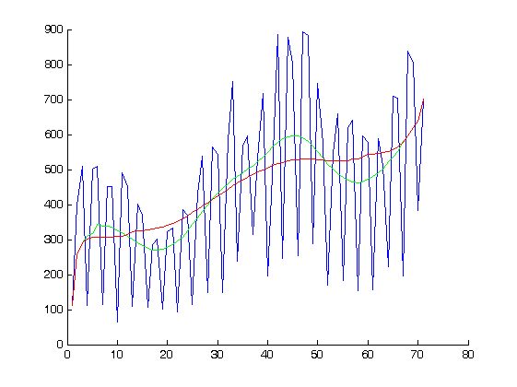
Implementation
→ Motion estimation
Need to smooth the data (running average) :
_window_size :
10
24
Motion estimation
Frame number (72)

Slide 33
Implementation
Load data into a timeline for time remapping.
Questions :
How to express the dynamism ?
How to present the data in an intuitive way ?
How to reencode the video based on the previous representation ?

Slide 34
Implementation
→How to express the dynamism ?
Compute the mean μ of the data set.
Compute the ratio relatively to the average.
Represent the data with the help of a spline.

Slide 35
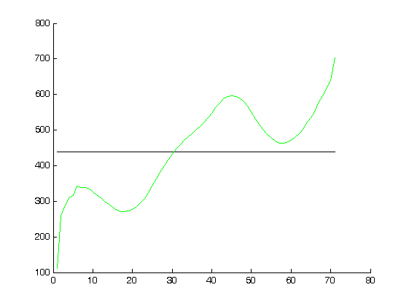
Implementation
Compute the mean μ of the data set.
Compute the ratio relatively to the average.
Represent the data with the help of a spline.
Motion estimation
μ
Frame number (72)

Slide 36
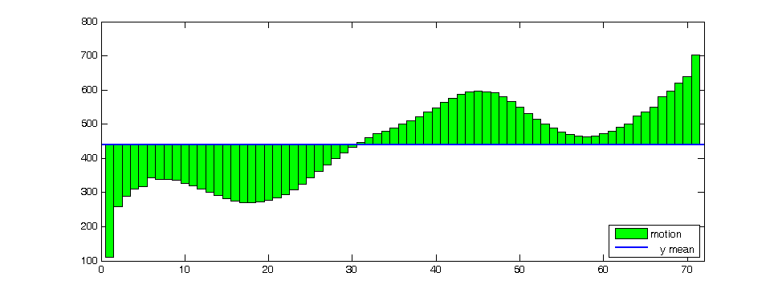
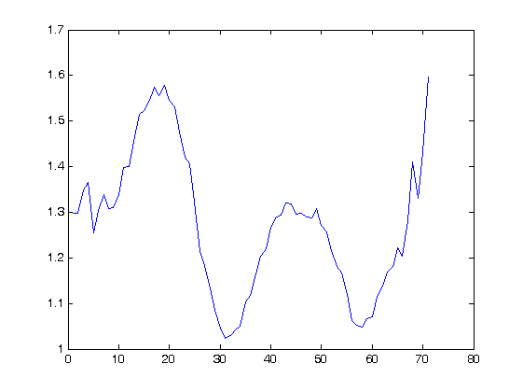
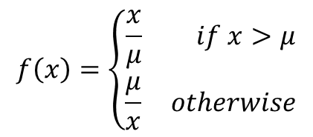
Implementation
Compute the mean μ of the data set.
Compute the ratio relatively to the average.
Represent the data with the help of a spline.
$$f\left(x\right)=\left\{\begin{aligned}\frac{x}{μ} if x>μ \\ \frac{μ}{x} otherwise\end{aligned}\right.$$

Slide 37
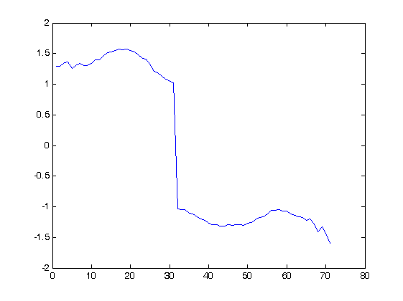
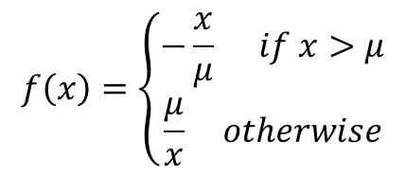
Implementation
Compute the mean μ of the data set.
Compute the ratio relatively to the average.
Represent the data with the help of a spline.
$$f\left(x\right)=\left\{\begin{aligned}−\frac{x}{μ} if x>μ \\ \frac{μ}{x} otherwise\end{aligned}\right.$$

Slide 38
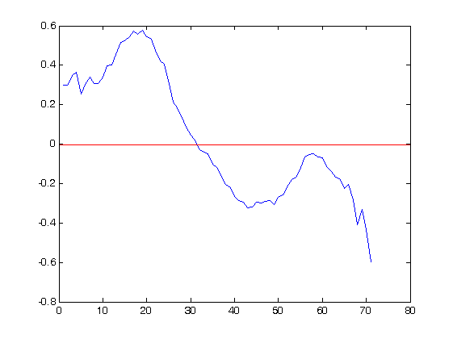
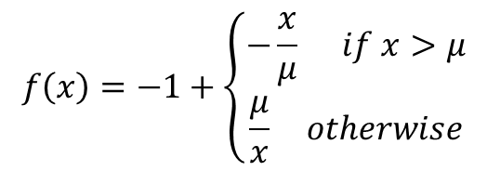
Implementation
Compute the mean μ of the data set.
Compute the ratio relatively to the average.
Represent the data with the help of a spline.
$$f\left(x\right)=−1+\left\{\begin{aligned}−\frac{x}{μ} if x>μ \\ \frac{μ}{x} otherwise\end{aligned}\right.$$

Slide 39
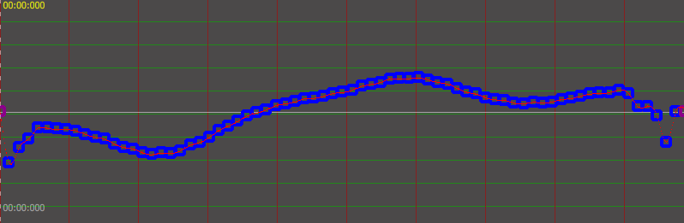
Implementation
→How to present the data ?
Compute the mean μ of the data set.
Compute the ratio relatively to the average.
Represent the data with the help of a spline.

Slide 40
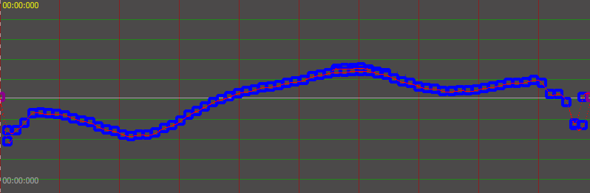
Implementation
→How to present the data ?
→How to present the data ?
Remove outliers with Chauvenet’s criterion and interpolate nearby values.
Compute the mean μ of the data set.
Compute the ratio relatively to the average.
Represent the data with the help of a spline.

Slide 41
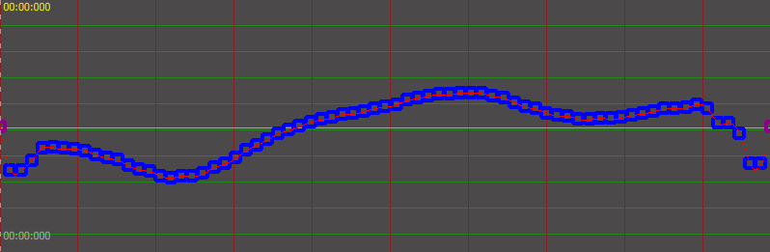
Implementation
→How to present the data ?
→How to present the data ?
Remove outliers with Chauvenet’s criterion and interpolate nearby values.
Compute the mean μ of the data set.
Compute the ratio relatively to the average.
Represent the data with the help of a spline.

Slide 42
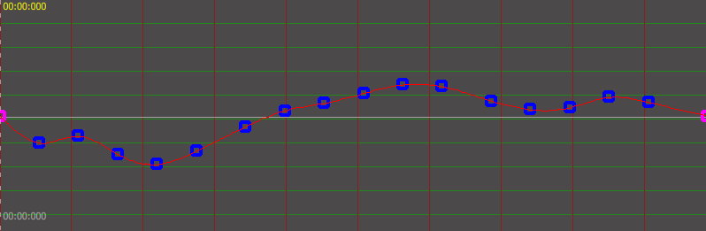
Implementation
→How to present the data ?
→How to present the data ?
Reduce the control points number using Least-Squares fitting.
Compute the mean μ of the data set.
Compute the ratio relatively to the average.
Represent the data with the help of a spline.

Slide 43
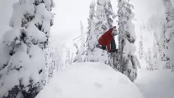










Implementation
→How to reencode the video ?
0.2
0.7
0.55
factor
0.5
f2
0.3
Accumated ratio :
0.4
f1
f2
0.0
$$+ F∗0.0$$
$$+ F∗0.3$$
$$+ F∗0.7$$
0.3
f1
timeline
100ms
112ms
128ms
148ms
$$100+40∗0.3$$
$$100+40∗0.7$$
$$140+40∗0.2$$

Slide 44
Implementation
→ Interpolation factors

Slide 45

Implementation
→ Interpolation factors
The duration of the video is changed.

Slide 46

results

Slide 47



results
minDistBetweenValues : 0.25, minClusterSize : 100, Background : 0.5
4x
minDistBetweenValues : 1.75, minClusterSize : 100, Background : 0.75

Slide 48

results

Slide 49


results
minDistBetweenValues : 0.5, minClusterSize : 10, Background : 0.5

Slide 50

results
minDistBetweenValues : 0.5, minClusterSize : 10, Background : 0.5

Slide 51


results
minDistBetweenValues : 1, minClusterSize : 100, Background : 0.1

Slide 52

results
minDistBetweenValues : 1, minClusterSize : 100, Background : 0.1

Slide 53


results
minDistBetweenValues : 0.5, minClusterSize : 10, Background : 0.5

Slide 54

results
minDistBetweenValues : 0.5, minClusterSize : 10, Background : 0.5

Slide 55


results
minDistBetweenValues : 0.5, minClusterSize : 10, Background : 0.5

Slide 56

results
minDistBetweenValues : 0.5, minClusterSize : 10, Background : 0.5

Slide 57
results
Conclusion :
Good result if the video
is in not too long (typically < 10sec)
optical flow of good quality
scene remains the same
Future work :
Extensible search of the optimal parameters.
More investigation on the meaning of the parameters.
Automatically cut long scenes in short sequences.
(Hire people to work with me.)

Slide 58


Software

Slide 59


Software

Slide 60
Questions ?
Thank you !

